Slide 1
Software Design Patterns

Slide 2
A brief review about object-oriented programming
Objects
Classes
Methods
Encapsulation
Polymorphism
Inheritance
Abstraction
Composition

Slide 3
The concept of design patterns
In software engineering, a design pattern is a general repeatable solution to a commonly occurring problem in software design.
Design patterns were first introduced by GoF (Gang of Four)
They are language-neutral
They are dynamic, as new patterns get introduced frequently.
They are time-tested and well-proven, which is the experience of developers and architects
They have reliability and dependence

Slide 4
Classifying patterns
The book by GoF on design patterns spoke about 23 design patterns and classified them under three main categories:
  Creational patterns
  Structural patterns
  Behavioral patterns
The classification of patterns is done based primarily on how the objects get created, how classes and objects are structured in a software application and also covers the way objects interact among themselves.

Slide 5
Creational patterns
They work on the basis of how objects can be created
They isolate the details of object creation
Code is independent of the type of object to be created
Example:
  Singleton Pattern

Slide 6
Structural patterns
They design the structure of objects and classes so that they can compose to achieve larger results
The focus is on simplifying the structure and identifying the relationship between classes and objects
They focus on class inheritance and composition
Example:
  The Attend Pattern

Slide 7
Behavioral patterns
They are concerned with the interaction among objects and responsibility of objects
Objects should be able to interact and still be loosely coupled
Example:
  The Observer Pattern

Slide 8
Creational Design Patterns

Slide 9
Singleton
Is a class which only allows a single instance of itself to be created and usually gives simple access to that instance.
Singleton is the best candidate when the requirements are as follows:
  If you need to control concurrent access to a shared resource
  If you need a global point of access for the resource from multiple or different parts of the system
  If you need to have only one object

Slide 10
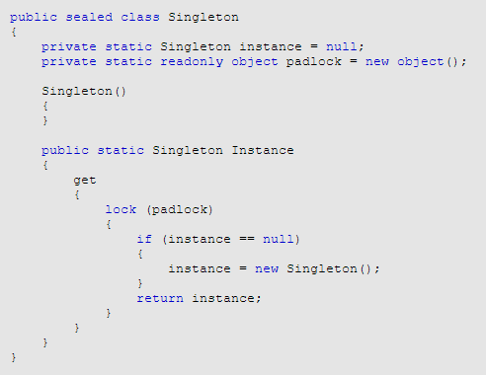
Singleton (II)

Slide 11
Builder Pattern
This pattern separates the construction of a complex object from its representation. By keeping the construction separate from the representation, the same construction can be used to create several different representations
We use the Builder pattern when we know that an object must be created in multiple steps, and different representations of the same construction are required

Slide 12
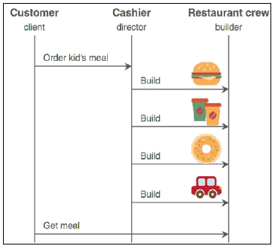
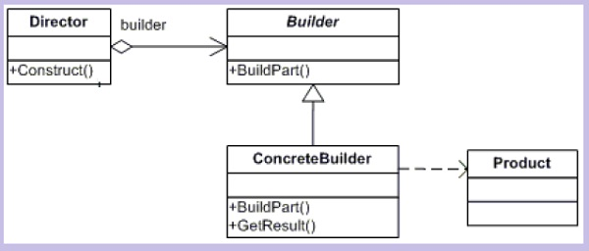
Builder Pattern (II)

Slide 13
Factory Pattern
In the Factory Method, we execute a single function, passing a parameter that provides information about what we want. We are not required to know any details about how the object is implemented and where it is coming from.
The main advantages of using the Factory Method pattern are:
  It makes code more universal, not being tied to concrete classes (ConcreteProduct) but to interfaces (Product) providing low coupling.
  It separates interfaces from their implementations

Slide 14
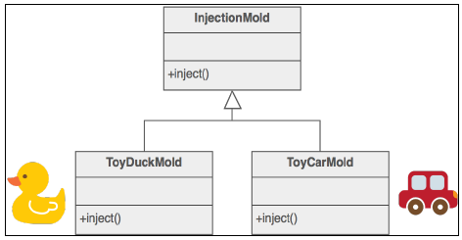
Factory Pattern (II)

Slide 15
Abstract Factory Pattern
The Abstract Factory design pattern is a generalization of Factory Method. Basically, an Abstract Factory is a (logical) group of Factory Methods, where each Factory Method is responsible for generating a different kind of object
The main advantages of using the Abstract Factory pattern are as follows:
  It simplifies the replacement of product families
  It ensures the compatibility of the products in the product's family
  It isolates the concrete classes from the client

Slide 16
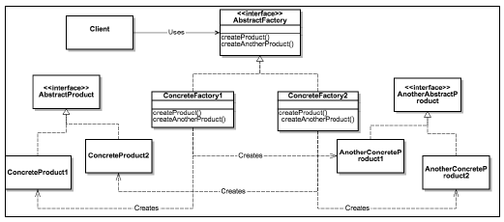
Abstract Factory Pattern (II)

Slide 17
Prototype Pattern
In its simplest version, the Prototype pattern is just a clone() function that accepts an object as an input parameter and returns a clone of it.
The Prototype pattern is useful when we have an existing object and we want to create an exact copy of it. A copy of an object is usually required when we know that parts of the object will be modified but we want to keep the original object untouched

Slide 18
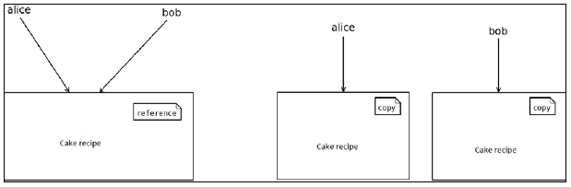
Prototype Pattern (II)

Slide 19
Estructural Design Patterns

Slide 20
Pattern Adapter
The Adapter pattern allows a system to use classes of another system that is incompatible with it.
Adapter pattern acts as a bridge between two incompatible interfaces. This pattern involves a single class called adapter which is responsible for communication between two independent or incompatible interfaces.
Does not require access to the source code of the foreign interface
Does not violate the open/closed principle

Slide 21
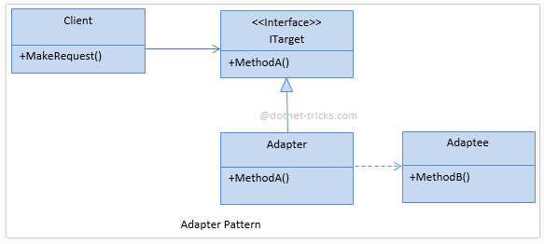
Pattern Adapter (II)

Slide 22
Pattern Bridge
Bridge pattern is used to separate an abstraction from its implementation so that both can be modified independently.
the Bridge Pattern's purpose is to provide multiple pathways between two components that are nothing but achieving many to many communication between multiple implementations of the source and the target components. So technically, it receives a request from one of the many implementations of the source component, and based on the client requirements, sends it to one of the many implementations of the target component

Slide 23
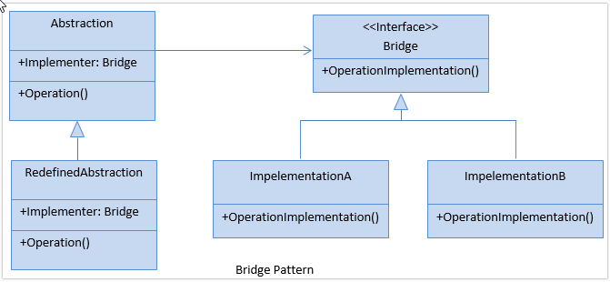
Bridge Pattern (II)
It’s often confused with the Adaptor pattern

Slide 24
Composite Pattern
Compose objects into tree structures to represent whole-part hierarchies. Composite lets clients treat individual objects and compositions of objects uniformly
Composite pattern is used when you need to set up objects into the tree structure to represent part-whole hierarchy. Within the tree structure every element is responsible to perform a task.

Slide 25
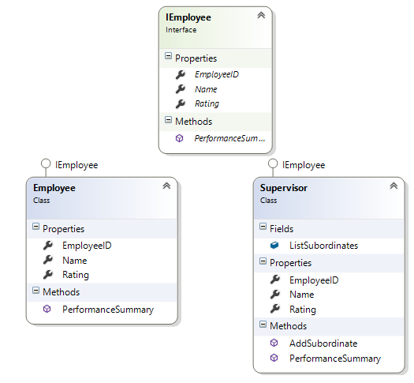
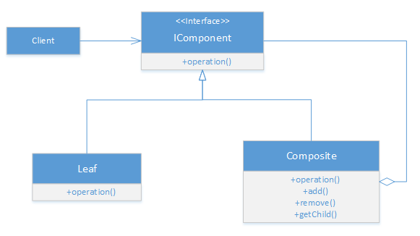
Composite Pattern (II)

Slide 26
Pattern Decorator
Decorator pattern can add responsibilities to an object dynamically and in a transparent manner (without affecting other objects)
This pattern is designed so that multiple decorators can be stacked on top of each other, each time adding a new functionality to the overridden method(s).
The Decorator pattern shines when used for implementing cross-cutting concerns:
  Data validation
  Logging

Slide 27
Facade pattern
The Facade (also known as Façade) design pattern helps us to hide the internal complexity of our systems and expose only what is necessary to the client through a simplified interface
In essence, Facade is an abstraction layer implemented over an existing complex system.
Facade is also useful if you have more than one layer in your system. You can introduce one Facade entry point per layer, and let all layers communicate with each other through their Facades

Slide 28
Facade Pattern (II)
the advantages of the facade design pattern:
  It maintains loose coupling between client and subsystems
  It provides an interface to a set of interfaces in a subsystem (without changing them)
  It wraps a complicated subsystem with a simplier interface
  Subsystem implementation gains ﬂexibility and clients gain simplicity

Slide 29
Flyweigth pattern
The Flyweight design pattern is a technique used to minimize memory usage and improve performance by introducing data sharing between similar object.
A Flyweight is a shared object that contains state-independent, immutable (also known as intrinsic) data.
Even if virtual memory provides us, theoretically, with unlimited memory, the reality is different. If all the physical memory of a system gets exhausted, it will start swapping pages to the secondary storage

Slide 30
Flyweigth pattern (II)
A flyweight object can be divided in two states:
  Intrinsic State: This is state independent data that generally remains constant and are stored in the memory. The intrinsic data in flyweight object can be shared.
  Extrinsic State: This is state dependent data that are not constant and needs to be calculated on fly (run time), so it cannot be stored in the memory. The extrinsic data cannot be shared.

Slide 31
Proxy Pattern
A proxy is a class, functioning as an interface to another class that has the same interface as the proxy.
The client code instantiates and works directly with the proxy, whereas, the proxy contains the real-object instance and delegates all calls to it, adding the proxy's own logic.
Proxies can also be used to distinguish between requesting an instance of an object and the actual need to access it. For example, program initialization may set up a number of objects that may not all be used right away. In that case, the proxy can load the real object only when it is needed.

Slide 32
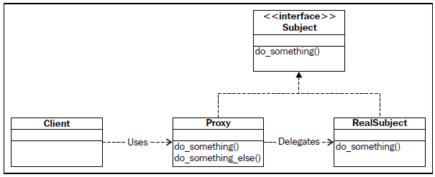
Proxy Pattern (II)
For example, program initialization may set up a number of objects that may not all be used right away. In that case, the proxy can load the real object only when it is needed.

Slide 33
Behavioral Design Patterns

Slide 34
Chain of responsability Pattern
The Chain of Responsibility pattern is used when we want to give a chance to multiple objects to satisfy a single request, or when we don't know which object (from a chain of objects) should process a specific request in advance
The principle is the same as the following
  There is a chain (linked list, tree, or any other convenient data structure) of objects.
  We start by sending a request to the first object in the chain.
  The object decides whether it should satisfy the request or not.
  The object forwards the request to the next object.

Slide 35
Command Pattern
The Command design pattern helps us encapsulate an operation (undo, redo, copy, paste, and so forth) as an object
What this simply means is that we create a class that contains all the logic and the methods required to implement the operation.
We don't have to execute a command directly. It can be executed on will.
The object that invokes the command is decoupled from the object that knows how to perform it.
If it makes sense, multiple commands can be grouped to allow the invoker to execute them in order

Slide 36
Interpreter Pattern
This pattern evaluates/ interprets the instructions written in a language grammar or notations.
This pattern involves implementing an expression interface which tells to interpret a particular context.
It describes creation of a language along with an interpreter for the language
The language can be used to represent states, actions, loops etc. depending on the programming requirement.

Slide 37
Iterator Pattern
The Iterator design pattern provides us with a common method of enumerating a list of items or array, while hiding the details of the list’s implementation
The iterator pattern can enumerate the list of items regardless of their actual storage type.
The Iterator design pattern is actually a quite common pattern in most object oriented programming languages

Slide 38
Mediator Pattern
The Mediator Design Pattern allows you to decouple the direct communication between objects by introducing a middle object, the mediator, that facilitates the communication between the objects
When an object needs to communicate with another object or a set of objects, it transmits the message to the mediator.
By eliminating the direct communication between objects, the mediator design pattern promotes loose coupling
Improves code readability and maintainability.

Slide 39
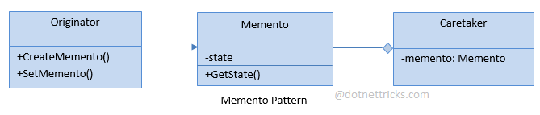
Memento pattern
The Memento design pattern can be used to provide an undo or rollback capability in an application or simply to reset the state of an object.
Without violating encapsulation, capture and externalize an object's internal state so that the object can be restored to this state later.

Slide 40
Observer Pattern
The Observer pattern describes a publish-subscribe relationship between a single object the publisher, which is also known as the subject or observable, and one or more objects, the subscribers, also known as observers
Using MVC as a example, the publisher is the model and the subscribers are the views.

